Slide 1


PGA-MAP-Elites
代码详解
小组成员：曾宪清 杨可芸 陈驿来
导师：刘佳琳
2022/11/17

Slide 2
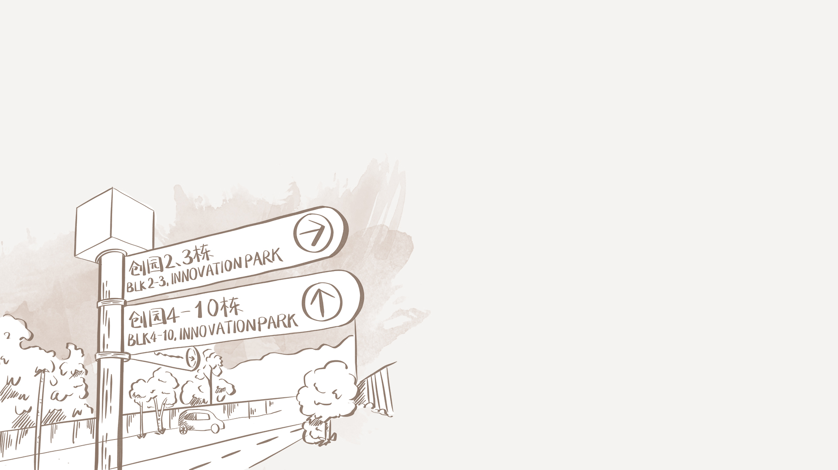
预期任务安排
时间 | 任务目标 | 实际完成
8 | 实现DQN并测试 | 成功实现DQN 参数有待优化
9 | 研读PGA-MAP-Elites论文 | 大致完成论文研读
10 | 结合代码了解PGA-MAP-Elites具体实现过程 | 结合代码对PGA-MAP-Elites中的CVT,MAP-Elites及TD3算法的实现过程有了了解
11 | 复现PGA-MAP-Elites
12 | 准备中期报告和答辩PPT
13 | 结合文献调研及相关实验结果，探索并尝试PGA-MAP-Elites优化方向
14 | 在已定方向上完成PGA-MAP-Elites的改进优化
15 | 将改进优化的PGA-MAP-Elites在强化学习环境中测试，展示不同参数下的运行结果
16 | 准备最终报告和答辩PPT

Slide 3
CONTENTS
1. CVT-MAP-Elites
2. Map-Elites
3. TD3
4. 参考文献

Slide 4



1
CVT

Slide 5


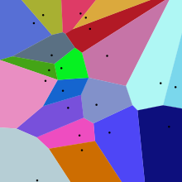
Voronoi diagram
沃罗诺伊图（Voronoi diagram）又叫狄利克雷镶嵌（Dirichlet tessellation）或者泰森多边形（Thiessen polygon）。沃罗诺伊图解决的问题实际上就是基于一组特定点将平面分割成不同区域，而每一区域又仅包含唯一的特定点，并且该区域内任意位置到该特定点的距离比到其它的特定点都要更近。
(来自https://www.zhihu.com/question/20317274/
answer/96311519）
(沃罗诺伊图. (2022, September 13). Retrieved from : https://zh.wikipedia.org/w/index.php?title=%E6%B2%83%E7%BD%97%E8%AF%BA%E4%BC%8A%E5%9B%BE&oldid=73642364）

Slide 6
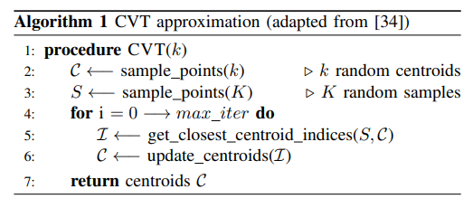
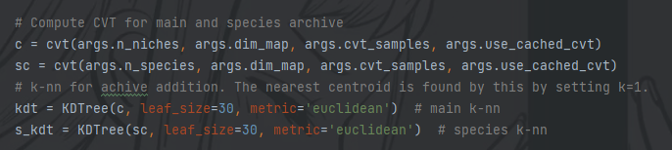
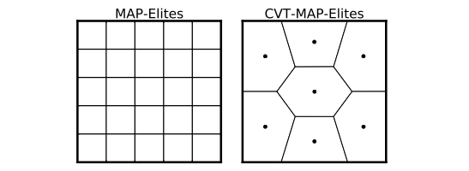
Centroidal Voronoi Tessellation (CVT) - MAP Elites
(Nilsson and Cully, 2021 main.py line188-193)
(Vassiliades, Chatzilygeroudis, & Mouret. 2017. Alg. 1)
(Vassiliades, Chatzilygeroudis, & Mouret. 2017. Fig. 1)

Slide 7
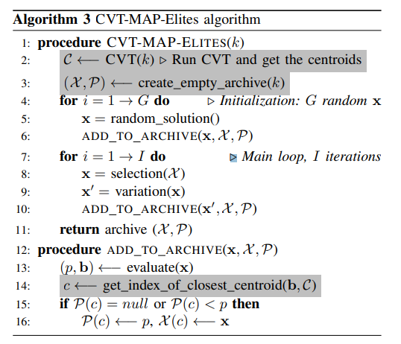
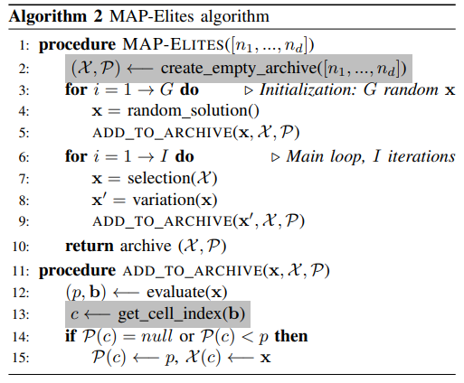
MAP-Elites vs CVT-MAP-Elites
(Vassiliades, Chatzilygeroudis, & Mouret. 2017 . Alg 2,3)

Slide 8
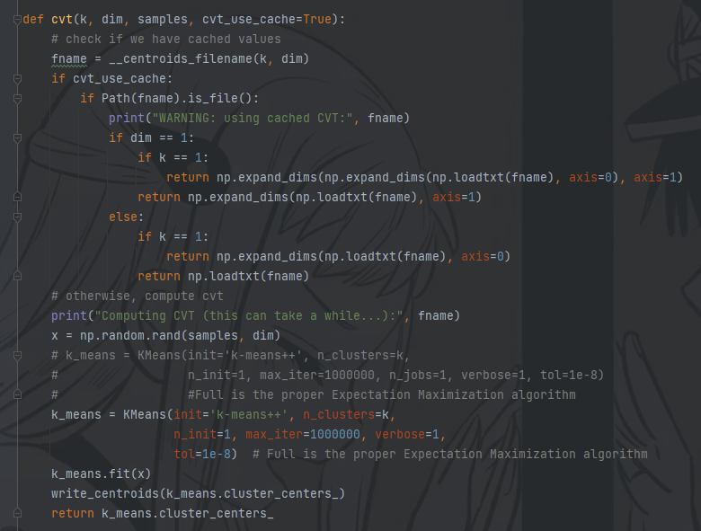
CVT method
(Nilsson and Cully, 2021 util.py line134-159)

Slide 9
2
MAP-Elites

Slide 10
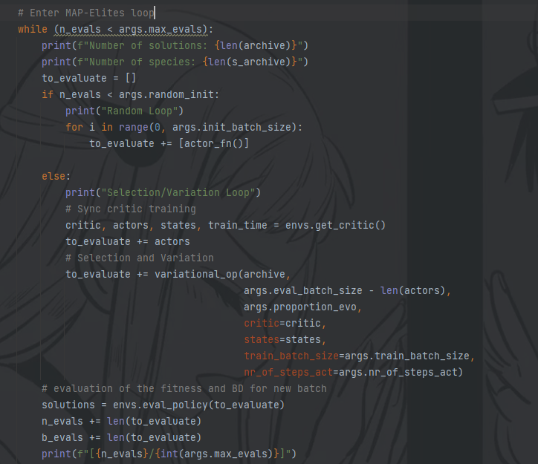
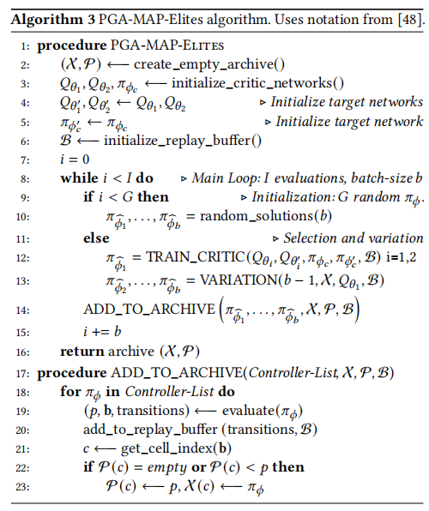
MAP-Elites
(Nilsson and Cully, 2021 main.py line201-228)
(Nilsson and Cully, 2021 Alg. 3)

Slide 11
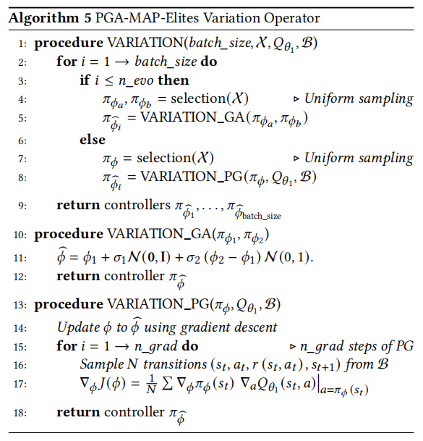
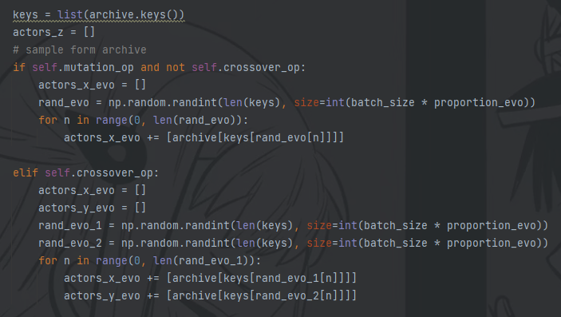
MAP-Elites
(Nilsson and Cully, 2021 variational_operator.py line169-185)
(Nilsson and Cully, 2021 Alg. 5)

Slide 12
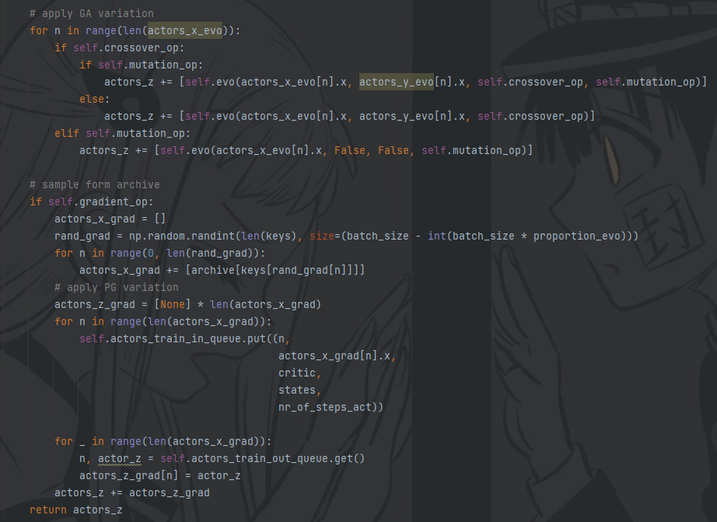
MAP-Elites
(Nilsson and Cully, 2021 variational_operator.py line169-185)
(Nilsson and Cully, 2021 Alg. 5)

Slide 13
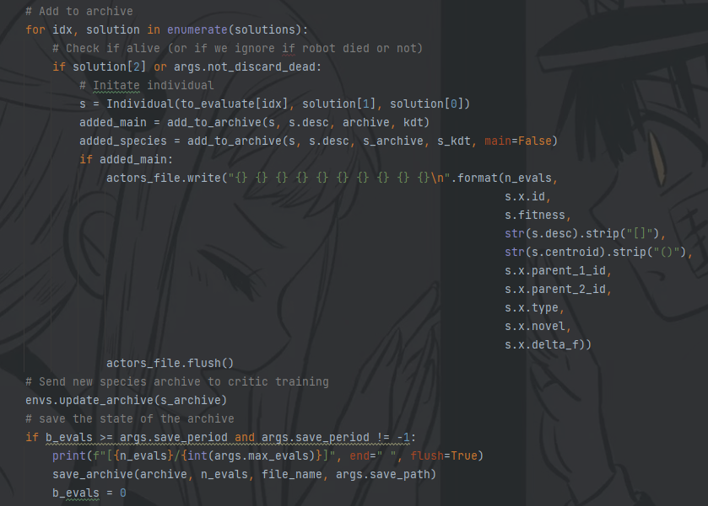
MAP-Elites
(Nilsson and Cully, 2021 main.py line229-255)
(Nilsson and Cully, 2021 Alg. 3)

Slide 14
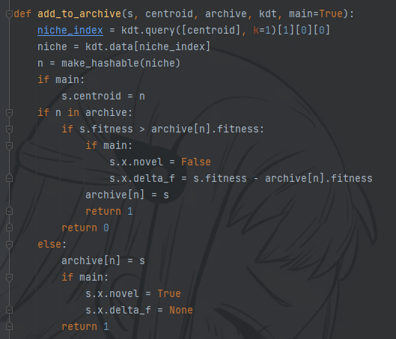
MAP-Elites
(Nilsson and Cully, 2021 util.py line97-116)
(Nilsson and Cully, 2021 Alg. 3)

Slide 15
3
TD3

Slide 16
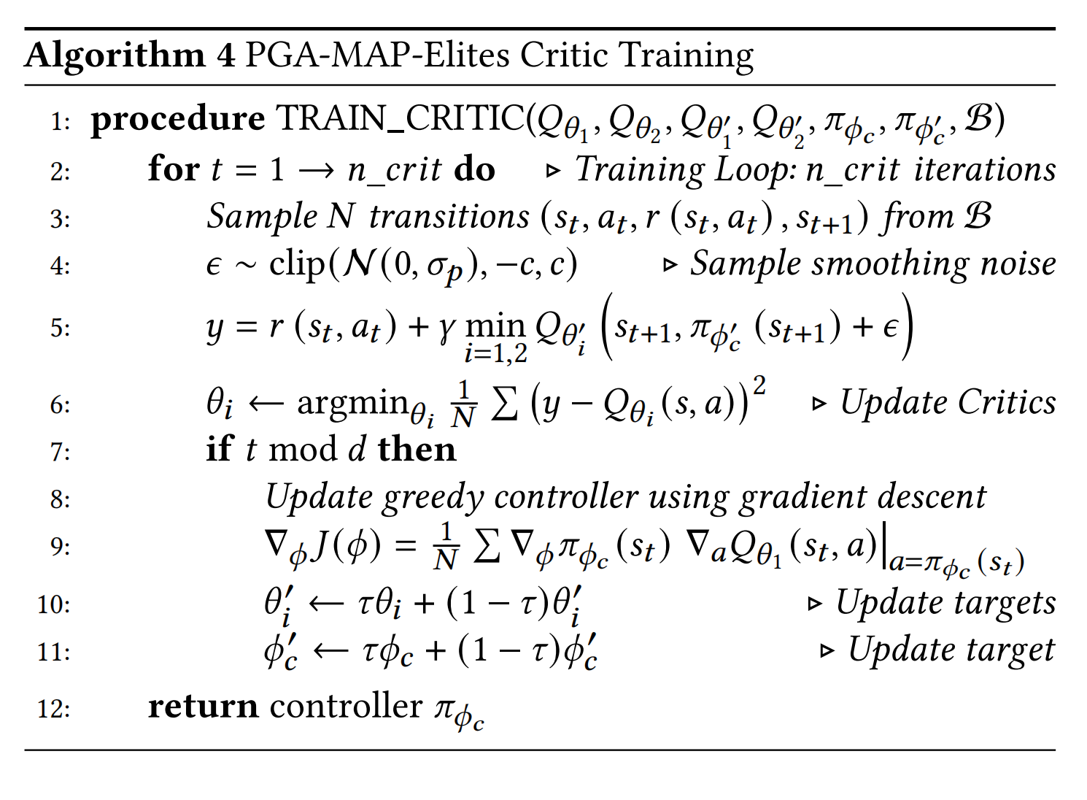
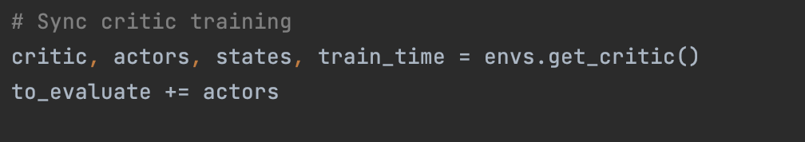
TD3
(Nilsson and Cully, 2021 Alg. 3)

Slide 17
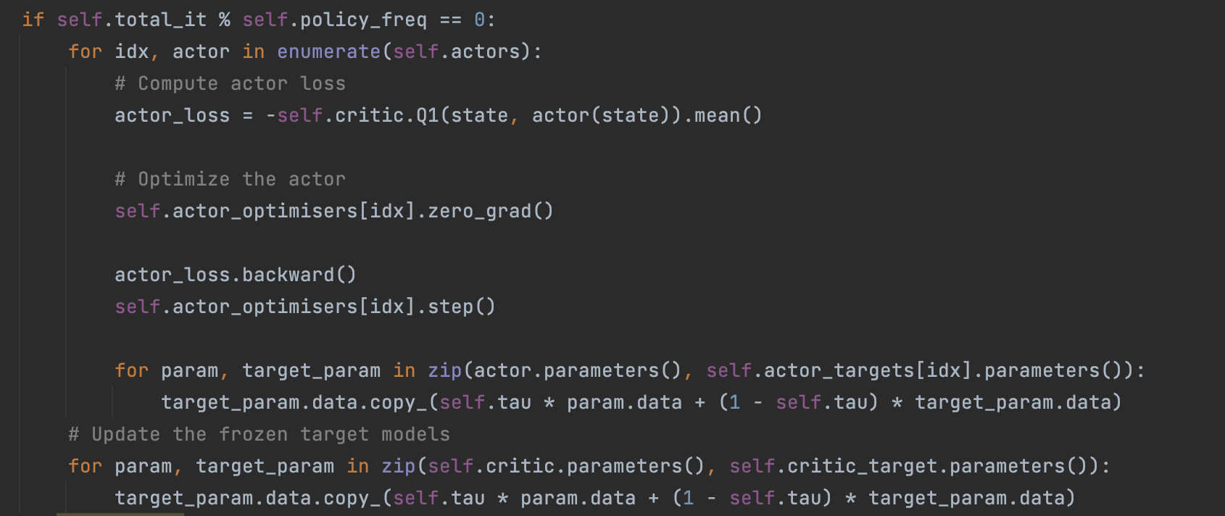
TD3
Delayed policy updates
(Nilsson and Cully, 2021 Alg. 3)

Slide 18
4
参考文献

Slide 19
参考文献
[1] J.-B. Mouret and J. Clune, “Illuminating search spaces by mapping elites,” arXiv preprint arXiv:1504.04909, 2015.
[2] O. Nilsson and A. Cully, “Policy gradient assisted MAP-Elites,” in Proceedings of the Genetic and Evolutionary Computation Conference, 2021, pp. 866–875.
[3] Vassiliades, V., Chatzilygeroudis, K., & Mouret, J. B. (2017). Using centroidal voronoi tessellations to scale up the multidimensional archive of phenotypic elites algorithm. IEEE Transactions on Evolutionary Computation, 22(4), 623-630.

Slide 20
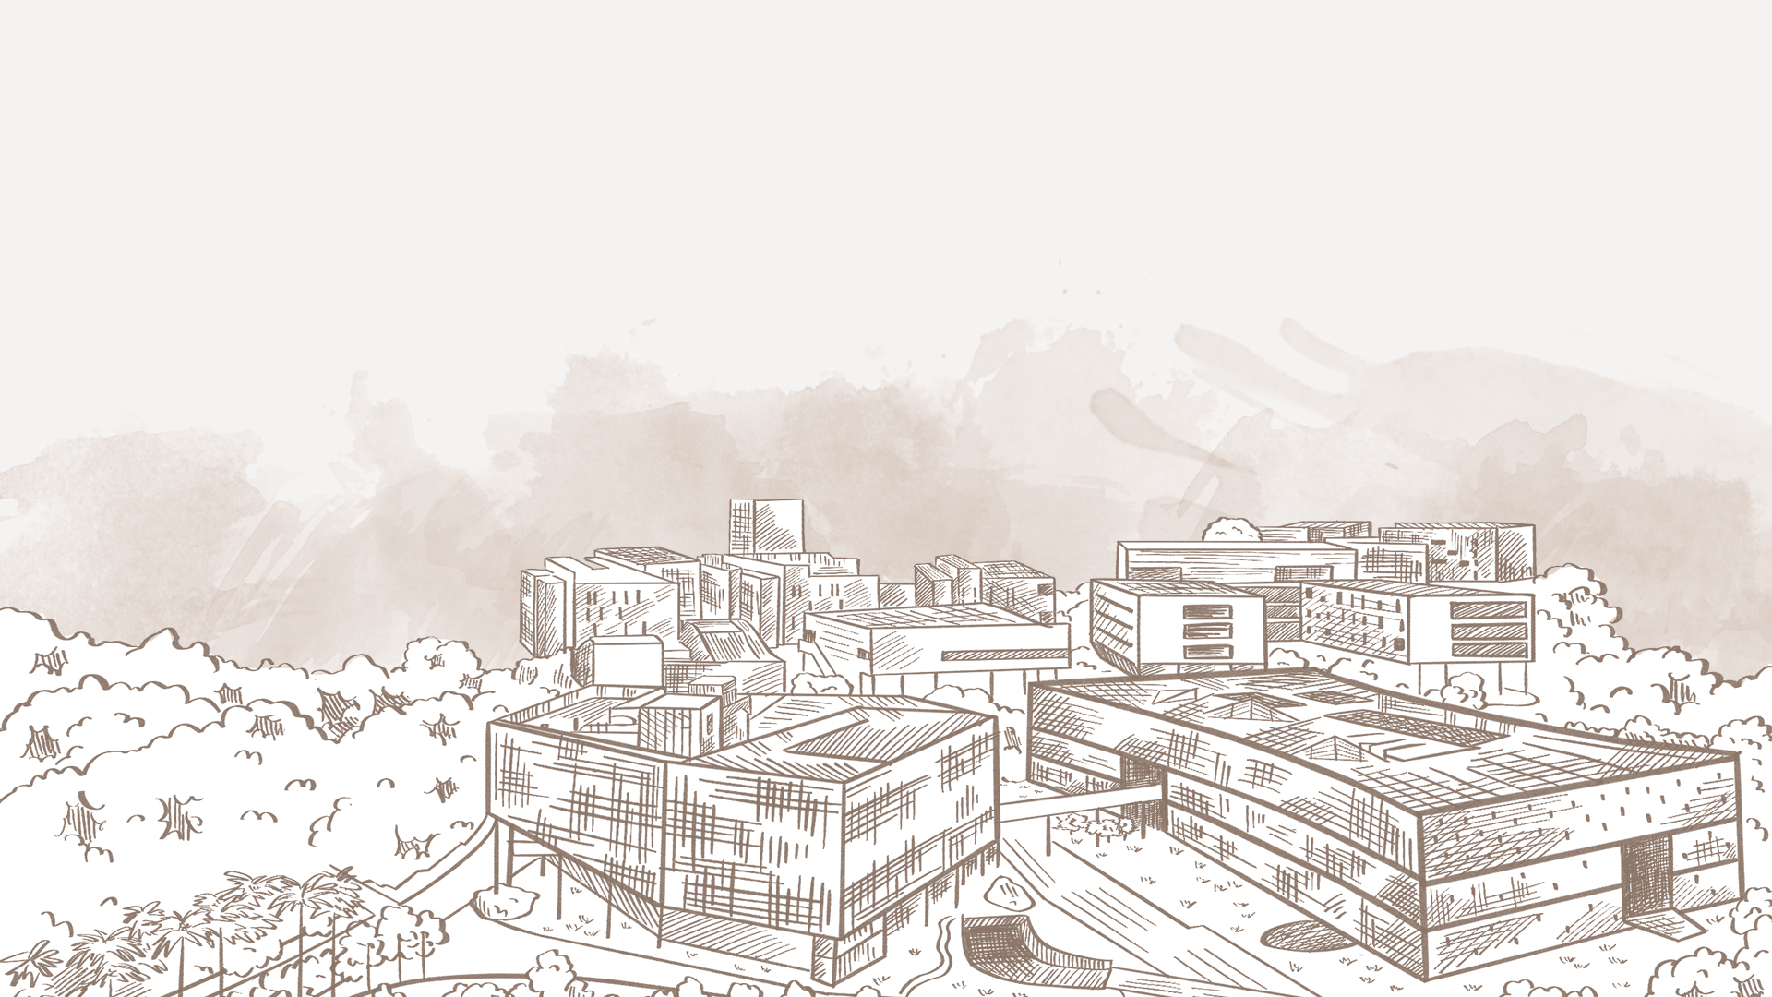
感谢
您的观看与收听

